Slide 1
Software Quality Assurance and Testing Technology
Haiming Liu
liuhaiming@bjtu.edu.cn
School of Software Engineering
Beijing Jiaotong University

Slide 2
Rules
25mins per Section
5mins break after a Section
10:10-10:35
10:40-11:05
11:10-11:35
11:40-12:00

Slide 3
Rules
Project 20%
Assignments 40%
Final Exam 40%

Slide 4
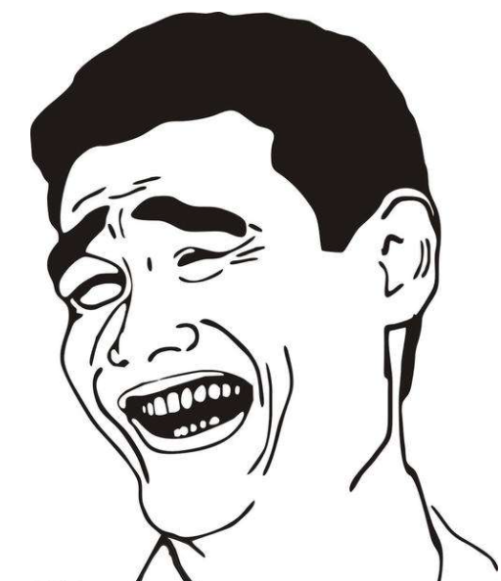

考试内容
选择题（20分）
判断题（10分）
填空题（10分）
概念题（20分）
综合题1（20分）
综合体2（20分）
开卷
全英

Slide 5
16 Weeks Plan
Week 1: The basic concepts and theories of testing
Week 2-3: Principles of Testing
Week 4: Test Cases
Week 5-6: Black Box Testing
Week 7-9: White Box Testing
Week 10: Integration Testing and System Testing
Week 11: Usability Testing and Accessibility Testing
Week 12: Security Testing
Week 13: Mutation Testing
Week 14: Software Quality
Week 15: Review I
Week 16: Review II

Slide 6
16 Weeks Plan
Week 1: The basic concepts and theories of testing
Week 2-3: Principles of Testing
Week 4: Test Cases
Week 5-6: Black Box Testing
Week 7-9: White Box Testing
Week 10: Integration Testing and System Testing
Week 11: Usability Testing and Accessibility Testing
Week 12: Security Testing
Week 13: Mutation Testing
Week 14: Software Quality
Week 15: Review I
Week 16: Review II

Slide 7
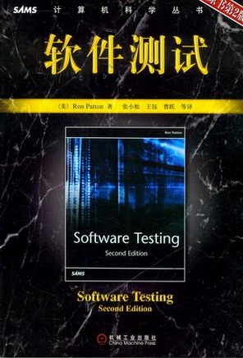

How
References
Ron Patton, Software Testing (2th Edition)
Glenford J. Myers, The Art of Software Testing (3rd Edition)
Gerald M. Weinberg, Perfect Software
Whittaker J A, Arbon J, Carollo J. How Google tests software

Slide 8
What is Testing
Software testing is a process, or a series of processes, designed to make sure computer code does what it was designed to do and, conversely, that it does not do anything unintended.
System
Input
Output

Slide 9
What is Testing
Unit testing
Integration testing
Testing levels
System testing
Acceptance testing

Slide 10
What is Testing
Black-box testing
Code
White-box testing
Gray-Box testing
Testing methods
Static testing
Run
Dynamic testing

Slide 11
What is Testing
GUI testing
Smoke testing
Functional testing
User Acceptance testing
Regression Testing
…………..

Slide 12
What is Testing
Load testing
Stress testing
Performance testing
Volume testing
Security testing
…………..

Slide 13
What is Testing
Testing levels
Acceptance
Functional
system
integration
WHAT
unit
Gray-Box
security
Testing methods
Volume
white box
black box
Stress
usability
Non-Functional
reliability
Load
HOW
Performance testing

Slide 14
Test Cycle
Test
cases
Execution of cases
Additional tests
Results
Suspected causes
Regression tests
Evaluation
Corrections
Identified causes
Debugging

Slide 15
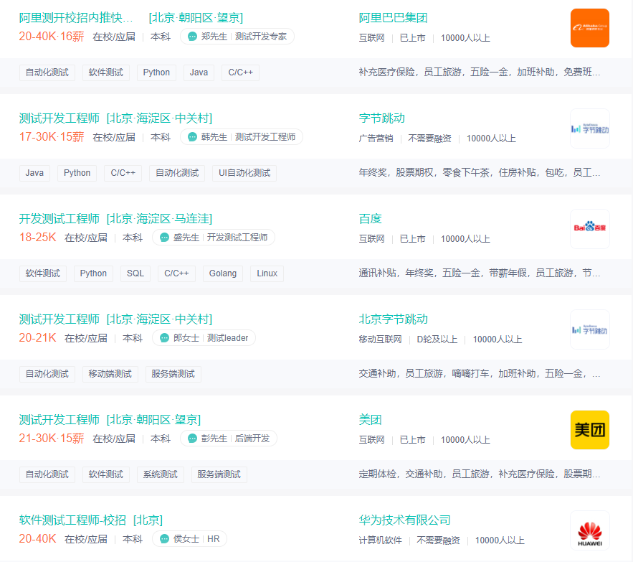
Tester Salaries
https://www.zhipin.com/

Slide 16
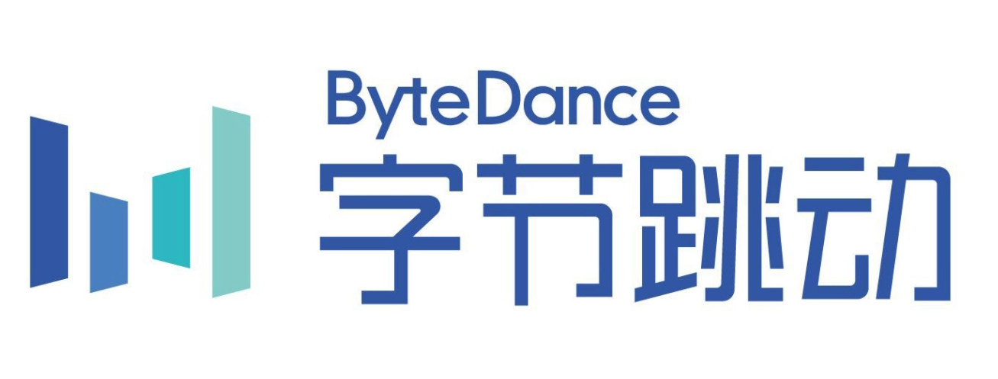

Tester Salaries
ByteDance
24K*15,three meals,Housing assistance ￥1500 per month
Kuaishou
25K*16,three meals,Housing assistance ￥2000 per month

Slide 17

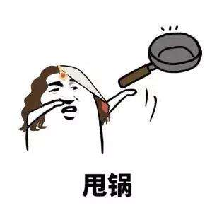
Developer and Tester
People are really hard to admit that they are wrong !
Tester
Bugs
Wrong
requirement
PM
Code
Developer

Slide 18
What
Let’s see how well you are
We want to design a program
The program reads three integers from an input box
The three integers represent three edges of a triangle
The program will tell you the triangle is scalene, isosceles or equilateral
2
3
2
3
3
3
Equilateral
isosceles

Slide 19
1
2
3
1
2
Test Case
3
3
3
1
1
1
3
5 min

Slide 20
How many “Yes” you got?
Do you have a test case that represents a valid scalene triangle? (Note that test cases such as 1, 2, 3 and 2, 5, 10 do not warrant a yes answer because a triangle having these dimensions is not valid.)
Do you have a test case that represents a valid equilateral triangle?
Do you have a test case that represents a valid isosceles triangle? (Note that a test case representing 2, 2, 4 would not count because it is not a valid triangle.)
Do you have at least three test cases that represent valid isosceles triangles such that you have tried all three permutations of two equal sides (such as, 3, 3, 4; 3, 4, 3; and 4, 3, 3)?
Do you have a test case in which one side has a zero value?
Do you have a test case in which one side has a negative value?
Do you have a test case with three integers greater than zero such that the sum of two of the numbers is equal to the third? (That is, if the program said that 1, 2, 3 represents a scalene triangle, it would contain a bug.)
2
3
4
3
3
3
1
0
1
1
-1
1
1
2
3

Slide 21
How many “Yes” you got?
Do you have at least three test cases in category 7 such that you have tried all three permutations where the length of one side is equal to the sum of the lengths of the other two sides (e.g., 1, 2, 3; 1, 3, 2; and 3, 1, 2)?
Do you have a test case with three integers greater than zero such that the sum of two of the numbers is less than the third (such as 1, 2, 4 or 12, 15, 30)?
Do you have at least three test cases in category 9 such that you have tried all three permutations (e.g., 1, 2, 4; 1, 4, 2; and 4, 1, 2)?
Do you have a test case in which all sides are zero (0, 0, 0)?
Do you have at least one test case specifying non-integer values (such as 2.5, 3.5, 5.5)?
Do you have at least one test case specifying the wrong number of values?
0
0
0
0.5
0.2
1
$
$
#
0
1
How many “Yes” you got?

Slide 22
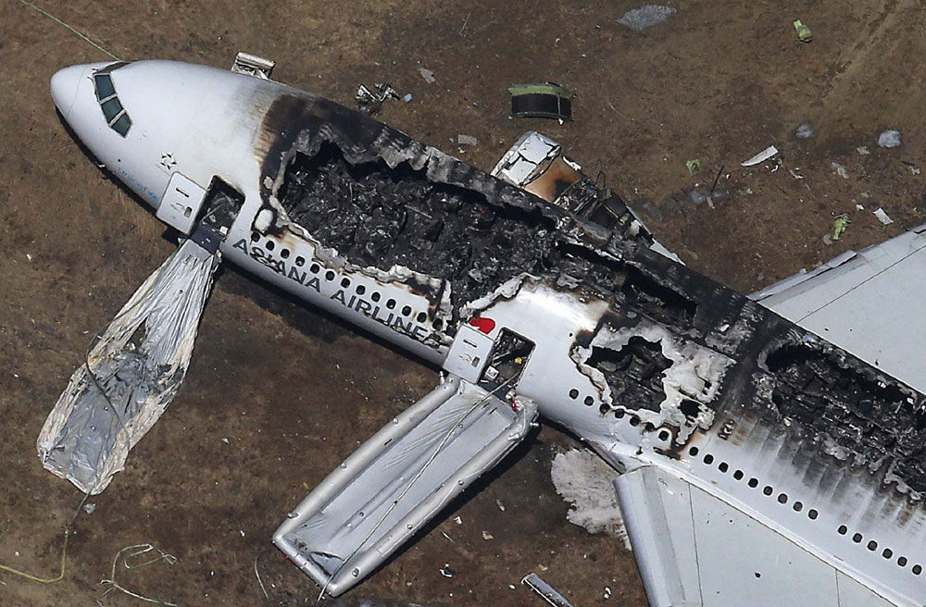
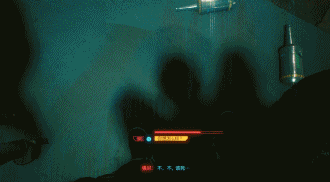
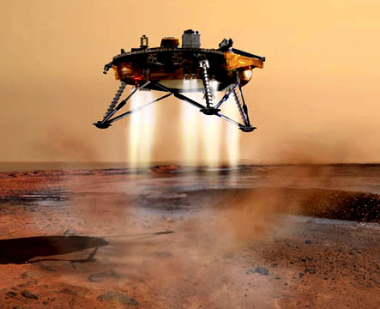
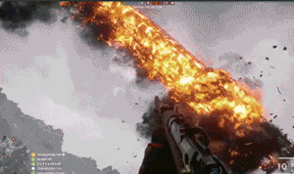


Why

Slide 23
Why
The Year 2000 problem, also known as the Y2K problem, the Millennium bug, Y2K bug, the Y2K glitch, or Y2K, refers to events related to the formatting and storage of calendar data for dates beginning in the year 2000. Problems were anticipated, and arose, because many programs represented four-digit years with only the final two digits – making the year 2000 indistinguishable from 1900 The assumption of a twentieth-century date in such programs could cause various errors, such as the incorrect display of dates and the inaccurate ordering of automated dated records or real-time events.
1.昭和-平成-令和
Japanese calendar era bug
2.Year 2038 problem

Slide 24
Why
The Mars Polar Lander, also known as the Mars Surveyor '98 Lander, was a 290-kilogram robotic spacecraft lander launched by NASA on January 3, 1999, to study the soil and climate of Planum Australe, a region near the south pole on Mars. It formed part of the Mars Surveyor '98 mission. On December 3, 1999, however, after the descent phase was expected to be complete, the lander failed to reestablish communication with Earth. A post-mortem analysis determined the most likely cause of the mishap was premature termination of the engine firing prior to the lander touching the surface, causing it to strike the planet at a high velocity.

Slide 25

Why
Two crashes of virtually new Boeing 737 MAXs just over four months apart were each initiated by a single malfunctioning sensor. In both cases, that trigger left the pilots in a deadly struggle against a new flight control system that ultimately forced their jet into a nose dive.

Slide 26
Why
On October 1, 2020, for the first time in its history, the Tokyo Stock Exchange had to suspend trading in all shares for a whole day due to a technical glitch, causing buying and selling to freeze.
On November 16, 2020,The Australian Securities Exchange has been forced to shut down completely after a software issue on its refreshed ASX Trade system created inaccurate market data. The technical issue coincided with the launch date for the upgraded ASX Trade system, which is provided by US exchange group Nasdaq.

Slide 27
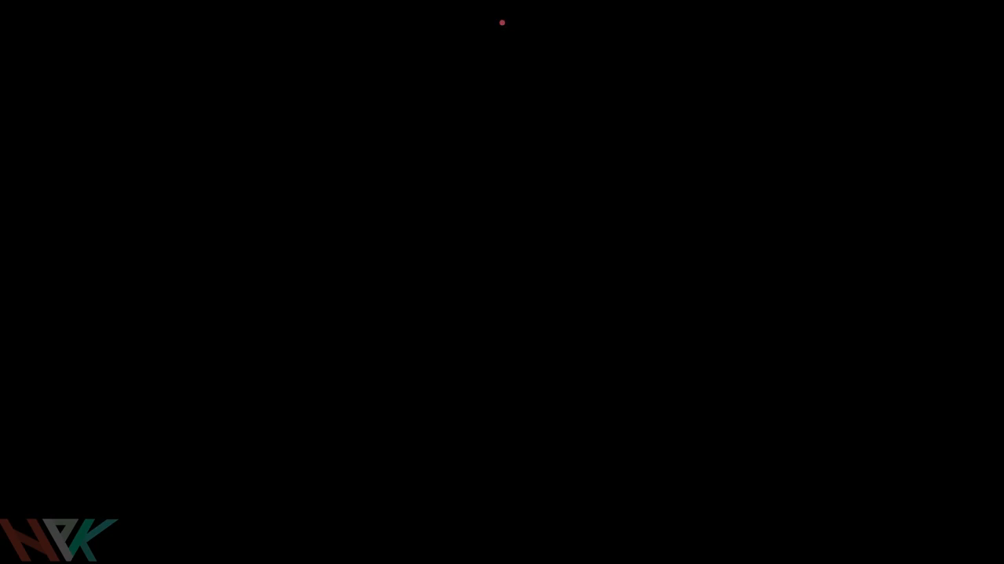
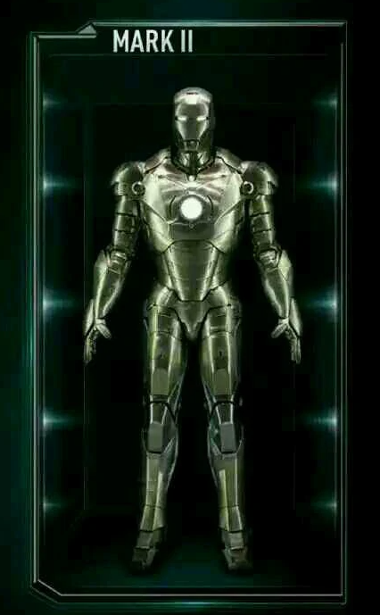
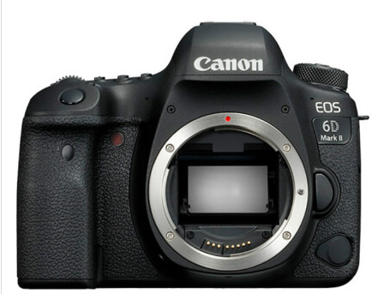
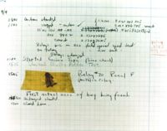
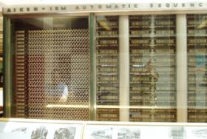
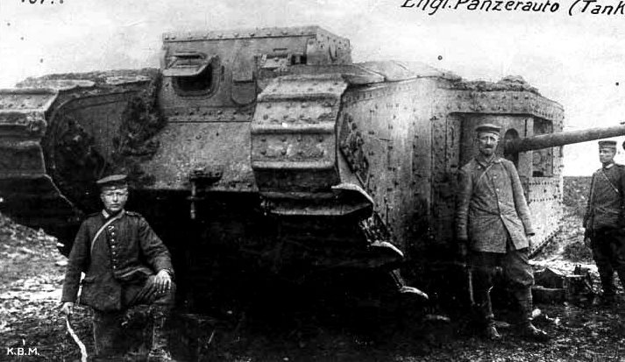
Introduction
What is a computer bug?
In 1947 Harvard University was operating a room-sized computer called the Mark II.
A moth flew into the computer and was zapped by the high voltage when it landed on a relay.
Hence, the first computer bug!

Slide 28

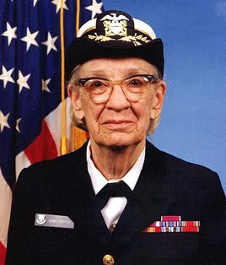
Introduction
Grace Hopper
Grace Brewster Murray Hopper was an American computer scientist and United States Navy rear admiral.
One of the first programmers of the Harvard Mark I computer, she was a pioneer of computer programming who invented one of the first linkers.
1906-1992

Slide 29
Introduction
Bugs a.k.a. …
Defect（缺点）
Fault（故障）
Problem（问题）
Error（错误）
Incident（事件）
Variance（偏差）
Failure（失败）
Inconsistency（不一致）
Anomaly（异常）

Slide 30
Introduction
Fault, Error & Failure
Software Fault : A static defect in the software (i.e., defect)
Software Error : An incorrect internal state that is the manifestation of some fault
Software Failure : External, incorrect behavior with respect to the requirements or other description of the expected behavior

Slide 31
Introduction
Software Fault : A static defect in the software (i.e., defect, bug)
public static void CSta (int [ ] numbers)
{
int length = numbers.length;
double mean, sum;
sum = 0.0;
for (int i = 1; i < length; i++)
{
sum += numbers [ i ];
}
mean = sum / (double) length;
System.out.println ("mean: " + mean);
}
Fault

Slide 32
Introduction
Software Error : An incorrect internal state that is the manifestation of some fault
public static void CSta (int [ ] numbers)
{
int length = numbers.length;
double mean, sum;
sum = 0.0;
for (int i = 1; i < length; i++)
{
sum += numbers [ i ];
}
mean = sum / (double) length;
System.out.println ("mean: " + mean);
}
Test Input: [3,4,5]
sum=3+4+5
sum=4+5
Error

Slide 33
Introduction
Software Failure : External, incorrect behavior with respect to the requirements or other description of the expected behavior
public static void CSta (int [ ] numbers)
{
int length = numbers.length;
double mean, sum;
sum = 0.0;
for (int i = 1; i < length; i++)
{
sum += numbers [ i ];
}
mean = sum / (double) length;
System.out.println ("mean: " + mean);
}
Test Input: [3,4,5]
sum=3+4+5
sum=4+5
Failure
mean=4
mean=3
Notes:
Software Failure:. (预期行为出错或与其他的外部行为描述不符)。指软件在运行时出现的功能的丧失，类似于看病时病人发病的症状。
本来传播出来的平均值应该是mean=4，实则传播出来的为mean=3

Slide 34
Introduction
Fault
public static void CSta (int [ ] numbers)
{
int length = numbers.length;
double mean, sum;
sum = 0.0;
for (int i = 1; i < length; i++)
{
sum += numbers [ i ];
}
mean = sum / (double) length;
System.out.println ("mean: " + mean);
}
Error
Failure

Slide 35
Introduction
PIE（Propagation-Infection-Execution） Model
Execution/Reachability : The location or locations in the program that contain the fault must be reached
Infection : The state of the program must be incorrect
Propagation : The infected state must propagate to cause some output of the program to be incorrect
Fault
Error
Failure

Slide 36
Introduction
Fault
public static void CSta (int [ ] numbers)
{
int length = numbers.length;
double mean, sum;
sum = 0.0;
for (int i = 1; i < length; i++)
{
sum += numbers [ i ];
}
mean = sum / (double) length;
System.out.println ("mean: " + mean);
}
Test Input: [3,4,5]
Error
Execution
sum=3+4+5
Infection
sum=4+5
mean=4
Propagation
mean=3
Failure

Slide 37
Introduction
A test executing the fault may not produce an error!
public static void CSta (int [ ] numbers)
{
int length = numbers.length;
double mean, sum;
sum = 0.0;
for (int i = 1; i < length; i++)
{
sum += numbers [ i ];
}
mean = sum / (double) length;
System.out.println ("mean: " + mean);
}
Test Input: [0,4,5]
sum=0+4+5
sum=4+5
Not an error for “sum”
mean=3
mean=3

Slide 38
Introduction
An error may not be propagated to the output!
Fault
public static void CSta (int [ ] numbers)
{
int length = numbers.length-1;
double mean, sum;
sum = 0.0;
for (int i = 0; i < length; i++)
{
sum += numbers [ i ];
}
mean = sum / (double) length;
System.out.println ("mean: " + mean);
}
Test Input: [3,5,4]
Error
sum=3+5+4
sum=3+5
mean=12/3=4
mean=8/2=4
No Failure
38

Slide 39
Introduction
A test
public int findLast (int[] x, int y)
{
//Effects: If x==null throw NullPointerException
// else return the index of the last element
// in x that equals y.
// If no such element exists, return -1
for (int i=x.length-1; i > 0; i--)
{
if (x[i] == y)
{
return i;
}
}
return -1;
}

Slide 40
Introduction
Defective Software
We develop programs that contain defects
How many? What kind?
Hard to predict the future, however…it is highly likely, that the software we (including you!) will develop in the future will not be significantly better. ☹

Slide 41
To be continued… See you next week

